Slide 1
Chongqing University of Technology
ATAI
Advanced Technique of Artificial Intelligence
Chongqing University of Technology
Text Classification Using Label Names Only: A Language Model Self-Training Approach（EMNLP 2020 ）
彭展望
Code:https://github.com/ yumeng5/LOTClass

Slide 2
Outline
Introduction
Related Work
Method
Experiment
Conclusion

Slide 3
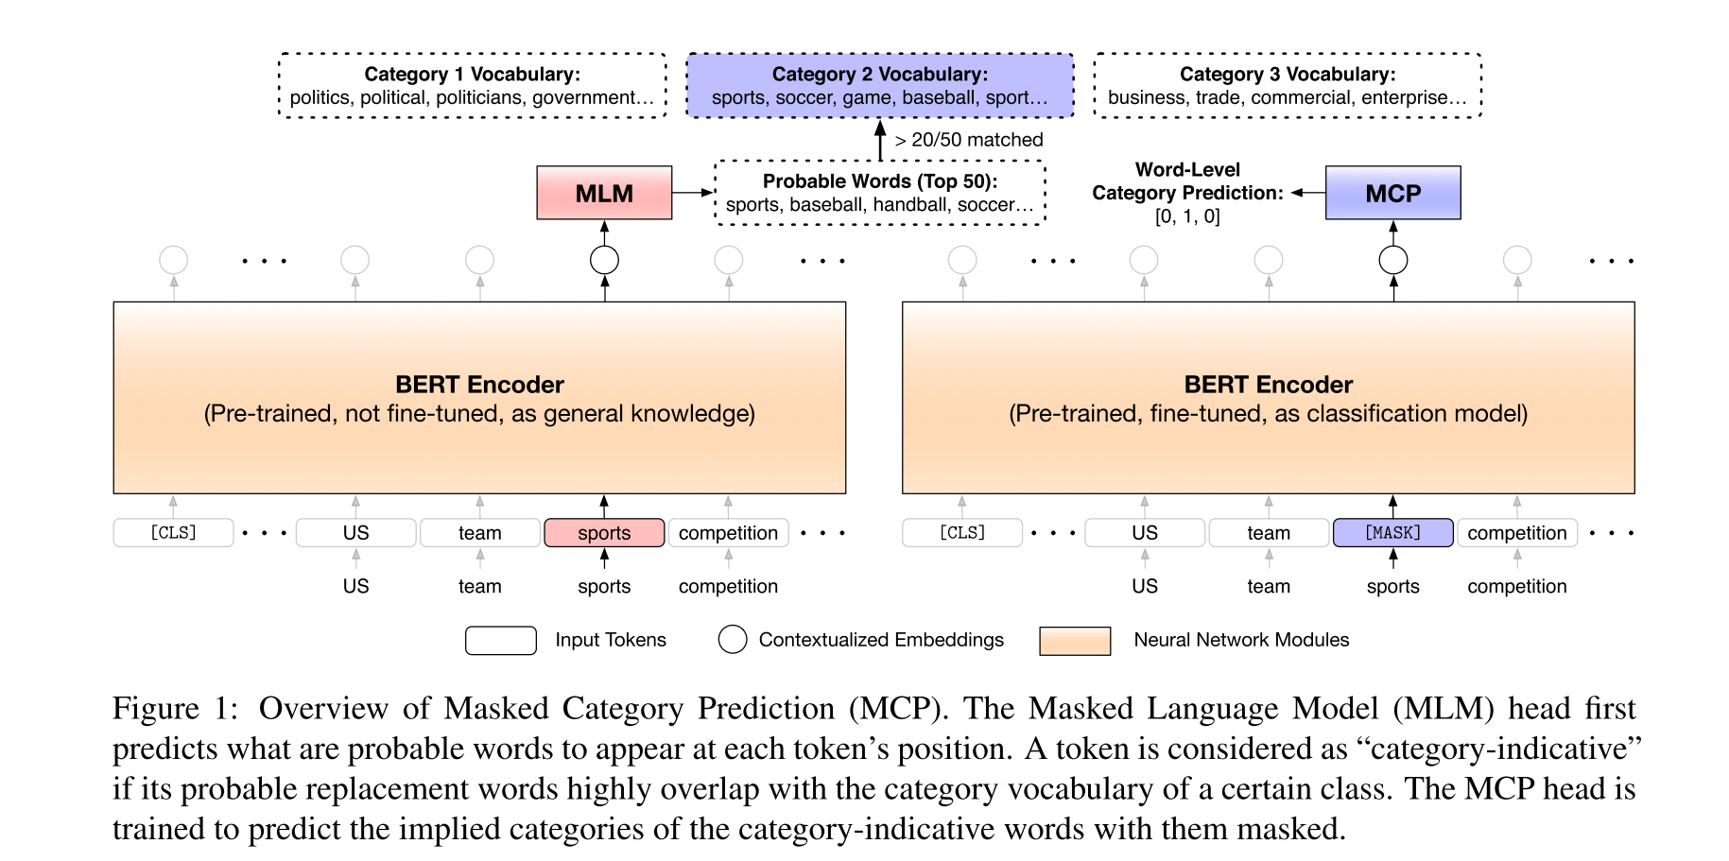
Method
1 Category Understanding via Label Name Replacement:
$V$ is the entire vocabulary
We observe that for each masked word, the top-50 predicted words usually have similar meanings with the original word, and thus we use the threshold of 50 words given by the MLM to define valid replacement for each occurrence of the label names in the corpus. Finally, we form the category vocabulary of each class using the top-100 words ranked by how many times they can replace the label name in the corpus, discarding stopwords with NLTK (Bird et al., 2009) and words that appear in multiple categories.

Slide 4
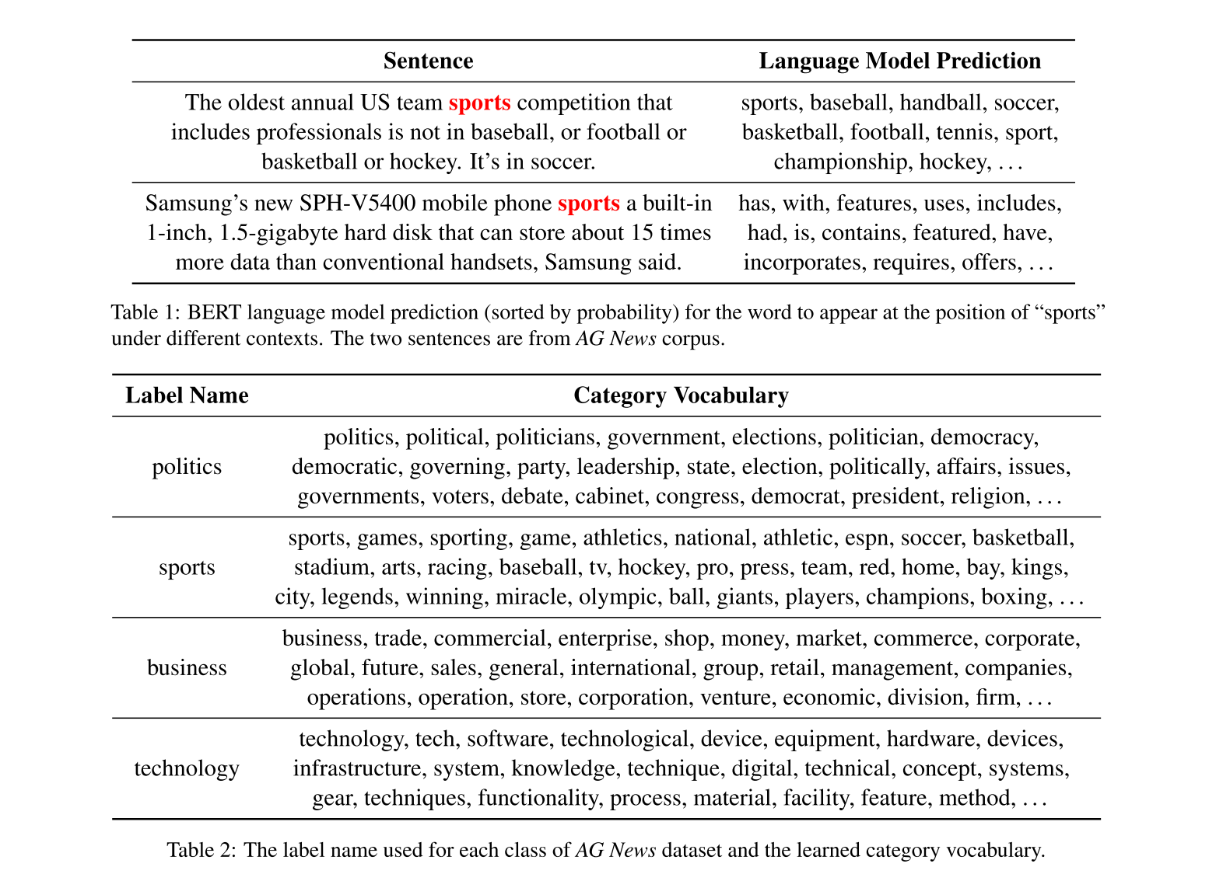

Slide 5
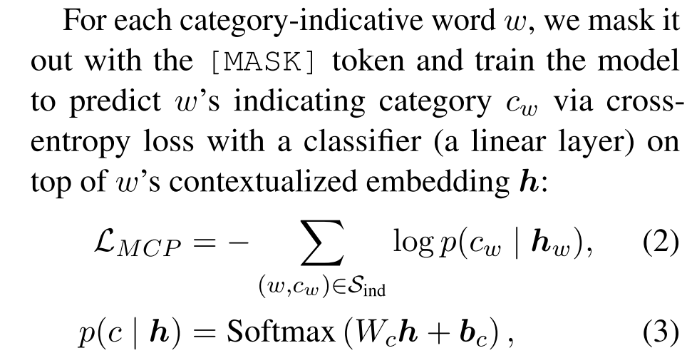
Method
2 Masked Category Prediction:
As before, we regard the top-50 words given by the MLM as valid replacement of the original word, and we consider a word $w$ as “category-indicative” for class $c_{w}$if more than 20 out of 50 $w$’s replacing words appear in the category vocabulary of class $c_{w}$. By examining every word in the corpus as above, we will obtain a set of category-indicative words and their category labels $S_{ind}$ as word-level supervision.
$K$ is the number of classes

Slide 6
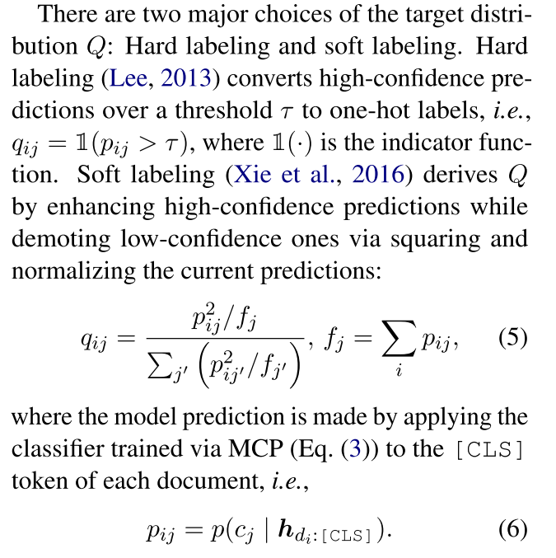
Method
3 Self-training:
$N$ is the number of instances

Slide 7
Dataset

Slide 8
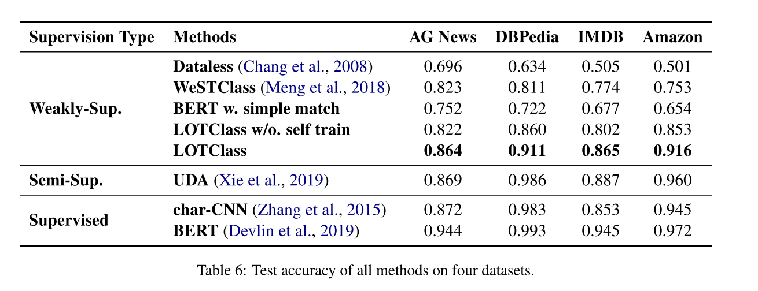
Experiment

Slide 9
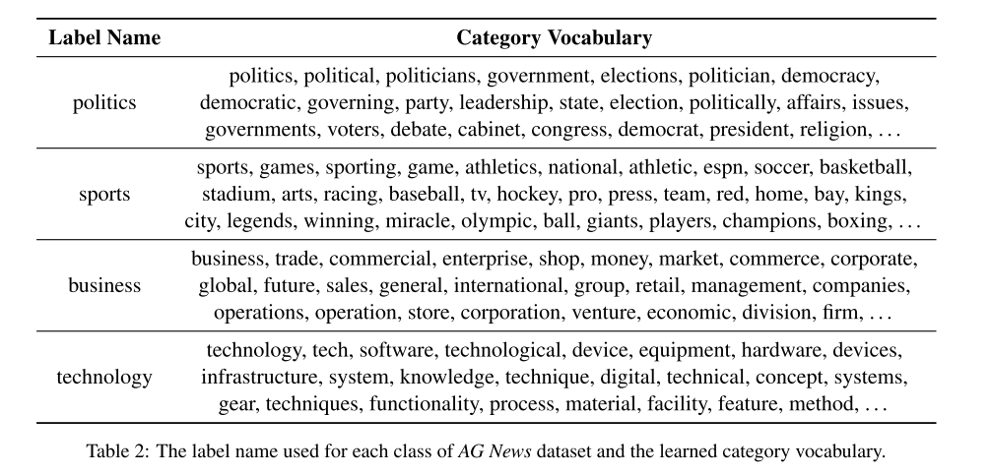
Notes:
我们使用商业和经济代替商业作为农业新闻数据集上的标签名称。表7显示了最终学到的类别词汇表。我们注意到，尽管标签名称发生了变化，但产生的类别词汇表中大约有一半的词汇表与原来的词汇表重叠(表2业务类别);另一半也表示非常相似的意思。这保证了我们方法的健壮性，因为在后续步骤中使用的是类别词汇表，而不是原始的标签名称。

Slide 10
Notes:
相对于其他解决方案的优势。我们以预先训练好的300d手套(Pennington et al.， 2014)为例，采用余弦相似度排名最高的单词与标签名称进行类别词汇构建。在亚马逊的数据集,我们使用好的和坏的标签名称,和类别的词汇由LOTClass(表4)准确地反映了情绪极性,而手套(表8)给出的结果是接近贫穷有些字好/坏手套嵌入空间中不显示情绪,甚至逆转情绪坏是好的(最接近的词)。这是因为上下文无关的嵌入只从本地上下文窗口学习，而神经系统LMs捕获长期依赖，导致准确解释目标词。

Slide 11
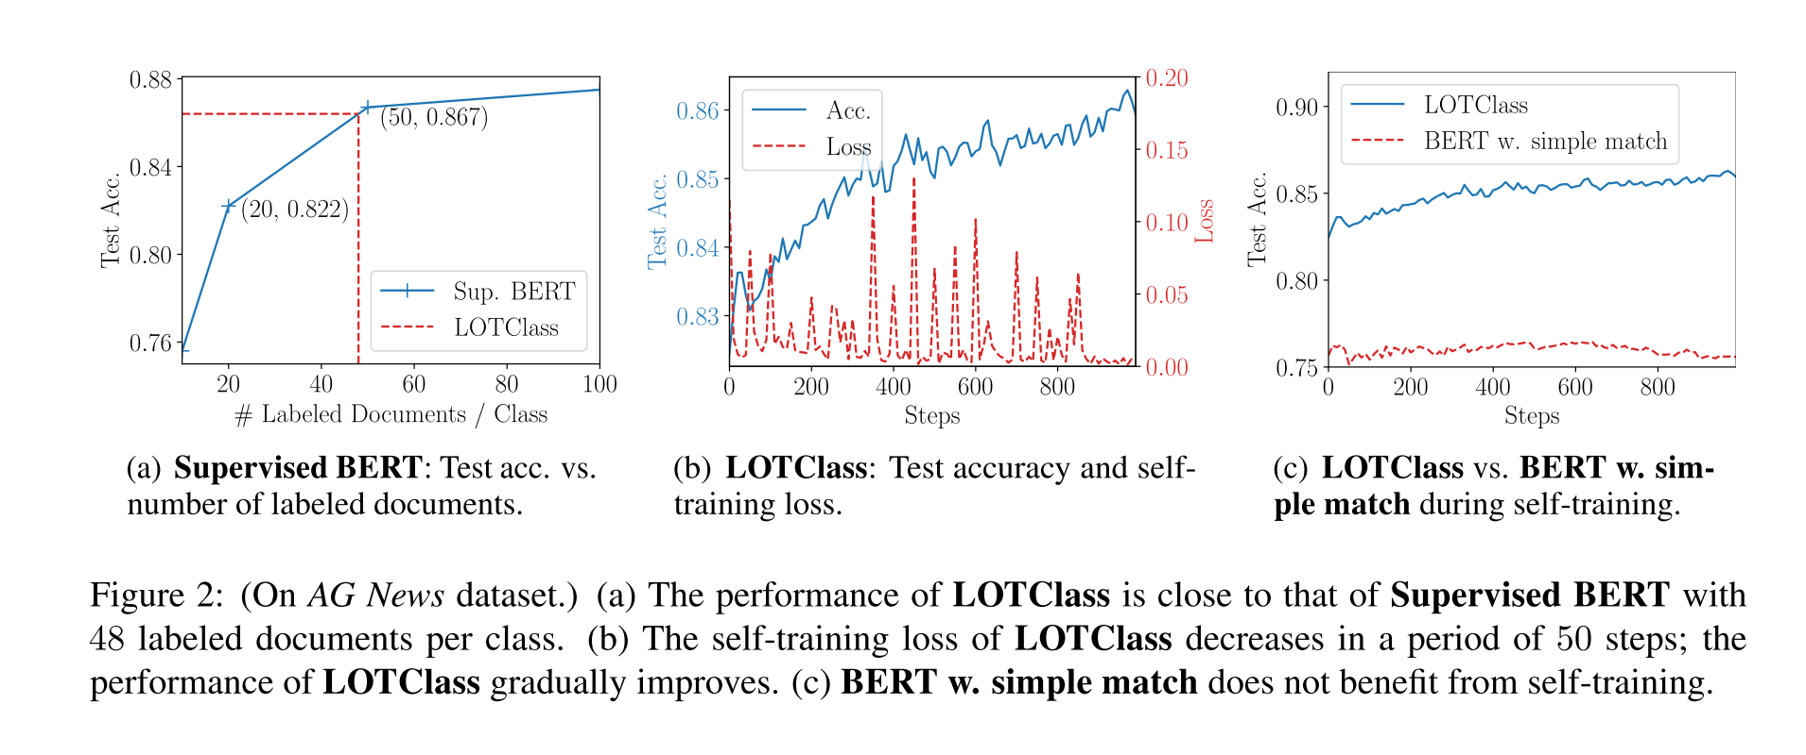
Experiment
Notes:
在图2(b)中，我们显示了对未标记文档的前1000步(批次)进行LOTClass训练时的测试准确性和自训练损失(Eq.(4))。可以观察到，损失在50步的周期内减小，这是目标分布Q的更新区间。当自训练损失接近于零时，模型拟合了之前的Q，并根据最近的预测计算出新的目标分布。随着模型对无标记数据的迭代化，性能逐渐提高

Slide 12
Thanks

